Slide 1
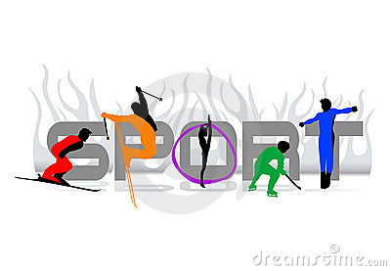
Khabarovsk 2012 г.

Slide 2
Sports — are all forms of competitive physical activity which, through casual or organized participation, aim to use, maintain or improve physical fitness and provide entertainment to participants
People all over the world are fond of sports and games. Sport makes people healthy , keeps them fit, more organized and better disciplined. It unites people of different classes and nationalities.

Slide 3
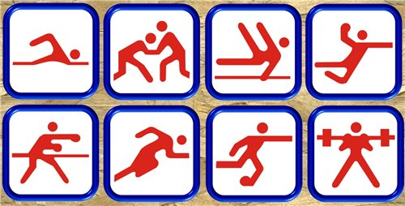
Different kinds of sports
swimming
wrestligg
gymnastics
volleyball
boxing
Running
football
Weight-lifting

Slide 4
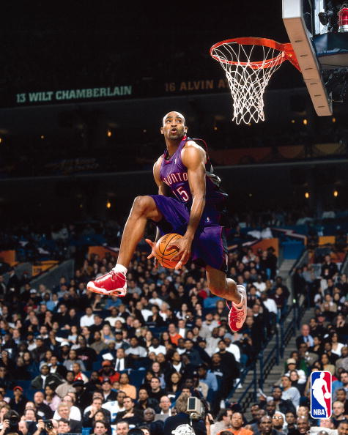
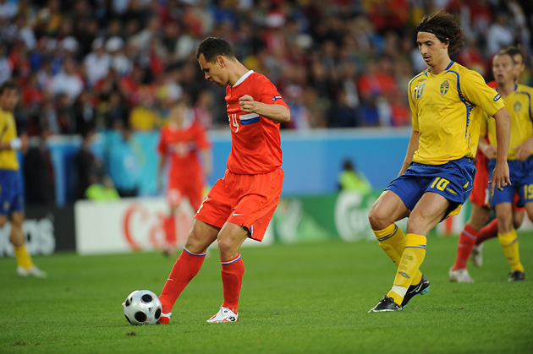
Summer sports
Football
Football refers to a number of sports that involve, to varying degrees, kicking a ball with the foot to score a goal. The most popular of these sports worldwide is association football, more commonly known as just "football" or "soccer".
Basketball
Basketball is a team sport, the objective being to shoot a ball through a basket horizontally positioned to score points while following a set of rules. Usually, two teams of five players play on a marked rectangular court with a basket at each width end.

Slide 5
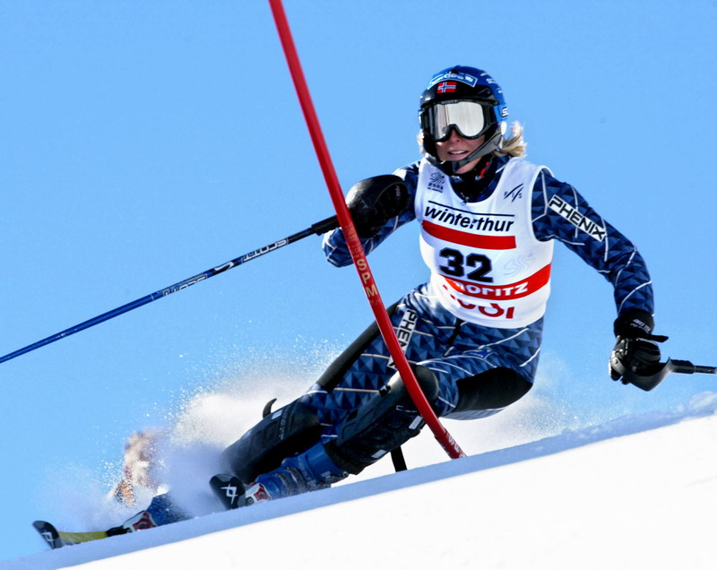
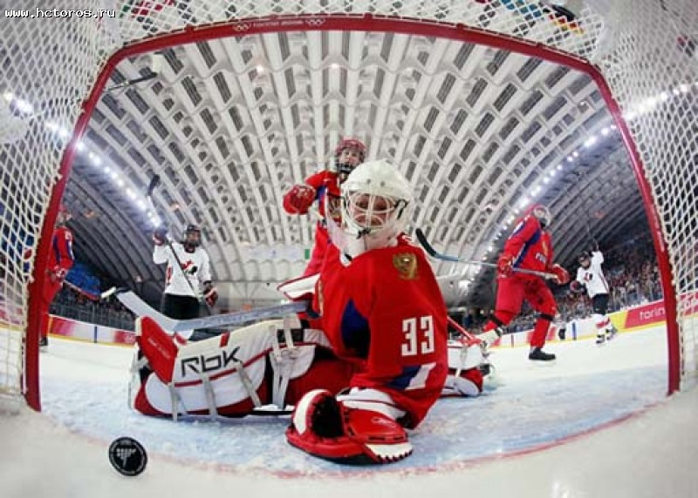
Winter sports
Hockey
Hockey is a family of sports in which two teams play against each other by trying to maneuver a ball or a puck into the opponent's goal using a hockey stick.
Skiing
Skiing is a way of traveling over snow, using skis strapped to one's feet. In modern times it has been mostly an athletic activity. Skis are used in conjunction with boots that connect to the ski with use of a binding.

Slide 6
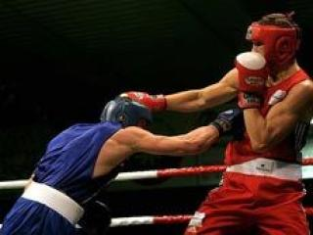
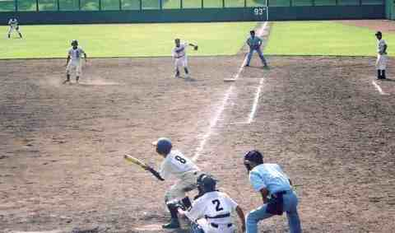
Some facts about sports.
Baseball - is a bat-and-ball sport played between two teams of nine players each. The aim is to score runs by hitting a thrown ball with a bat and touching a series of four bases arranged at the corners of a ninety-foot diamond.
Boxing, also called pugilism, is a combat sport in which two people engage in a contest using only their fists.
There are two forms of boxing: amateur and professional. Amateur boxing is an Olympic and Commonwealth sport and is a common fixture in most of the major international games - it also has its own World Championships.

Slide 7
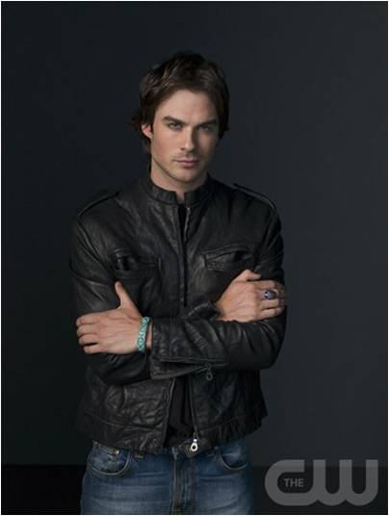
My attitude to sport
I would like to tell you about my attitude to sport. Sport is very important in my life. We meet it since the first days of the life. Sport helps me to understand the life better. So sport is very important for every young person and it plays a great role in my life.

