Slide 1
SEASON AND WEATHER
There are four seasons in the year: winter, spring, summer and autumn. Each of them lasts three months
Kugot N.N.

Slide 2
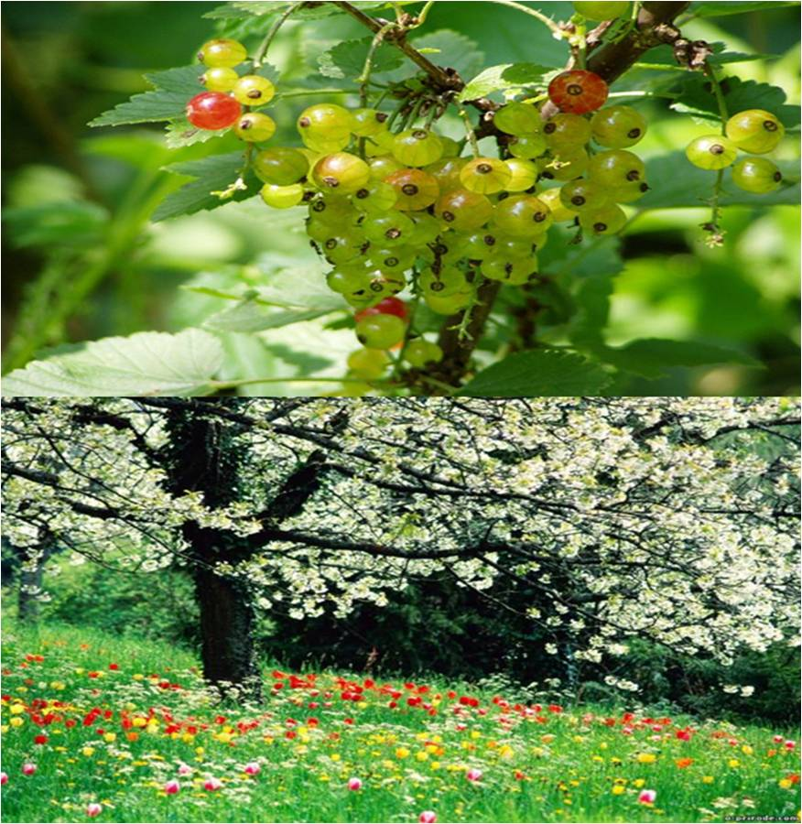
SUMMER
Summer is the hottest month in our country and comes during the months of June, July and August. When summer comes, the weather gets warmer and sometimes it can be very hot. In summer people spend much time in the open.

Slide 3
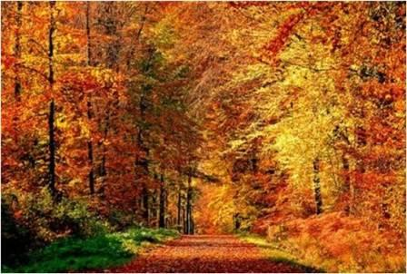
AUTUMN
AUTUMN comes in September with the beginning of school year. It is the time when fruit and vegetables become ripe. It is a very beautiful time of the year when the weather is still warm and the leaves change their colour from green to yellow and red.

Slide 4
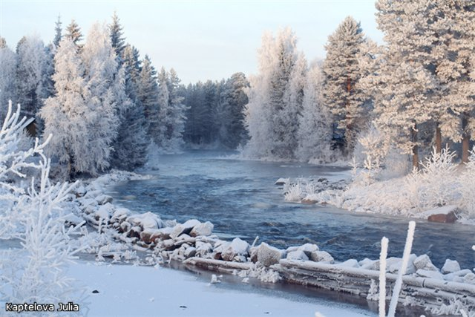
WINTER
Winter is usually a cold season. It often snows, rivers and lakes frozen. The sun sets early and rises late – especially in December and January. Every New Year begins in winter on the first of January.

Slide 5
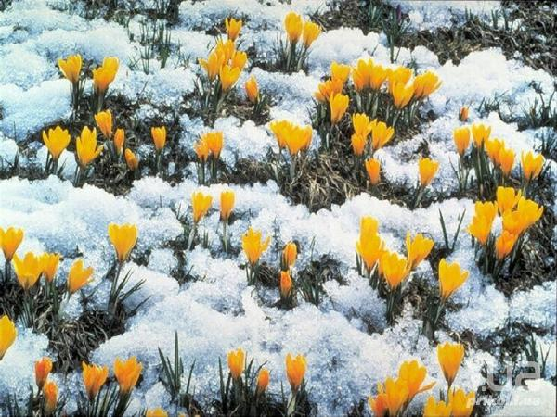
SPRING
Spring begins in March. The weather gets better and the sun shines more brightly. The bird return from the South and make their nests. It sometimes rains but the sky is usually bright-blue and it is warm..

Slide 6
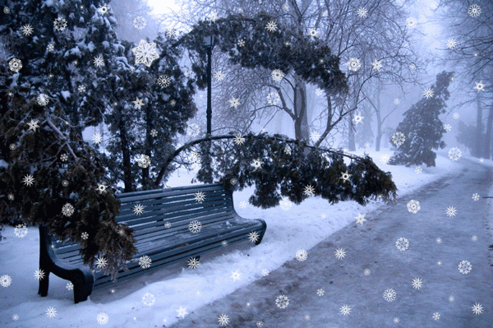
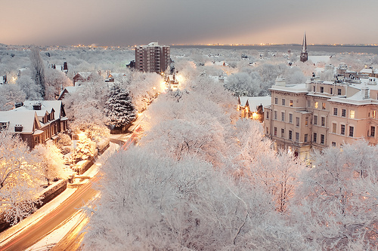

Slide 7
Winter at night

